Slide 1
Integrated Health Care for Co-infections and Conditions
Diane Havlir, University of California, San Francisco, USA

Slide 2
Introduction
The needs for persons living with HIV are changing, and we need to change accordingly
HIV infrastructure has not yet been adequately adapted to provide care for other diseases and services to promote health
We need to increase capacity for patient -centered, integrated health care for PWH that speak to their medical conditions and concerns beyond HIV
If we do not do this, we risk, in all parts of the world the gains we have made over the last 2 decades

Slide 3
Call for Integrated Health Care
Persons with HIV or at risk for HIV
Integrated Health Care
Persons with HIV or at risk for HIV
Sexually Transmitted infections, reproductive health
Hypertension, Diabetes
Substance use
Cancers ( e.g. cervical)
Mental Health
Tuberculosis, Hepatitis B and C, COVID-19
Populations of all ages
Vulnerable populations

Slide 4
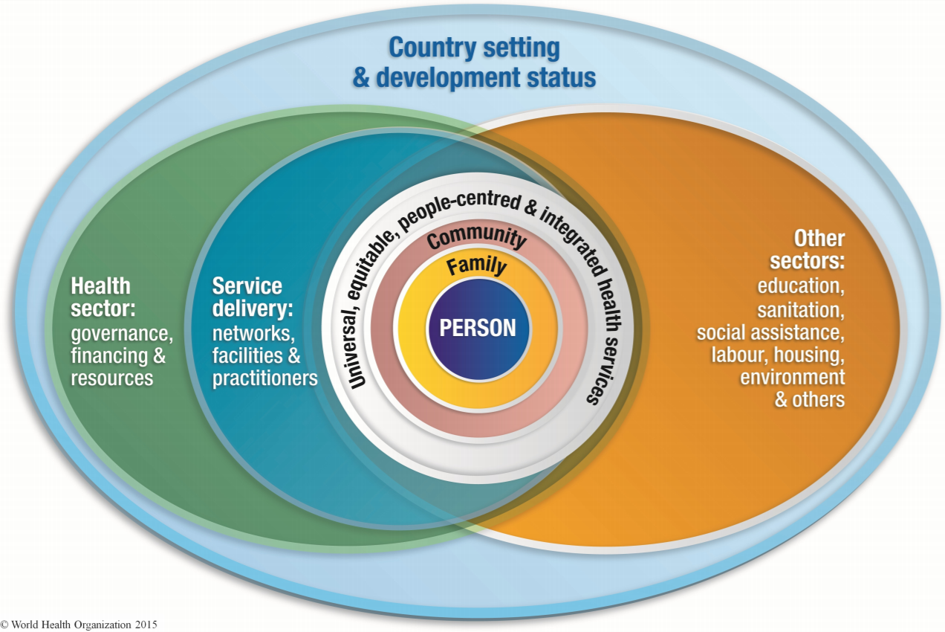
Person-centered approach is required to succeed

Slide 5
Speakers: Integrated Healthcare for Co-infections and Conditions
Designing services for people who use them, Olivier King Sibo, Burundi
Service integration to improve outcomes: opportunities and challenges, James Ayieko, Kenya
Evolving to meet the needs of the community, Tony Sillemon, United States
Integrating HIV and TB services: A community- based nurse’s perspective, Kaya Mlandu, South Africa

